Slide 1

xAPI –
The language of the Total Learning Architecture
RISC Inc
xAPI Collective 25 September 2026
.

Slide 2


Duncan Welder
Director of Client Services
DuncanW@RISC-Inc.com
https://www.linkedin.com/in/duncanwiv/

Slide 3

Imagine…
Completing an education program and receiving credit automatically in an online credentialing or badge system.

Slide 4

Imagine…
Documenting competence so work teams can be assembled nimbly.

Slide 5

Imagine…
Ensuring someone is training and qualified before they enter controlled areas.

Slide 6

Imagine…
Being able to lock out an IV Pump if a nurse’s training has expired.

Slide 7

Imagine…
Eliminating noise by forwarding only the xAPI statements you want to an authoritative LRS.

Slide 8

Imagine…
Being 100% in control of your data.
Putting it to work for you
Having confidence in its quality

Slide 9

Imagine…
Seeing xAPI fulfill its mission as core to the Learning Ecosystem, guiding business decisions and supporting learners through their entire career.

Slide 10

That’s the promise of the TLA
Lifelong Learning
System Interoperability
Data Driven
Competency-based and Adaptive Learning
Blended and On-Demand
Reduced Cost

Slide 11
Based on 4 Pillars
xAPI
IEEE 9274.1
Enterprise Learner Records
IEEE 2997
Learning Metadata
IEEE 2881
Sharable Competency Definitions
IEEE 1484.20.3
Learning Records Store
Learner
Profile
Experience Index
Competency
Registry
But wait, there’s more…
https://sagroups.ieee.org/ltsc/

Slide 12
Go from this…
Apps
Apps
SAAS
Apps
Apps
Apps
DB
Apps
Apps
SAAS
SAAS
Apps
DB
SAAS
DB
DB
DB
DB
Apps
DB
DB
Apps
SAAS
SAAS
Apps
Apps
Apps
Data
Warehouse
Apps
DB
SAAS
SAAS
DB
DB
Apps
DB
DB
Apps
DB
Apps
Apps
Data
Warehouse
Apps
DB
Apps
SAAS
DB
SAAS
Apps
DB
DB
Apps
DB
Apps
DB
DB
Image courtesy of the ADL

Slide 13
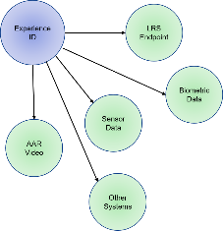
To this…
SAAS
Apps
SAAS
Apps
SAAS
SAAS
DB
Apps
Apps
Apps
Data
Apps
DB
DB
DB
DB
Apps
Apps
SAAS
Apps
SAAS
Apps
SAAS
SAAS
DB
Apps
Apps
Apps
Apps
DB
DB
DB
DB
Image courtesy of the ADL

Slide 14

Our Challenges
Systems that don’t “speak” xAPI
Inconsistent Vocabulary
“Noisy” xAPI
Legacy Systems
Others?
This Photo by Unknown Author is licensed under CC BY-SA

Slide 15
What does xACTION do?
Rule 1
Rule 2
Pattern Matching Engine
Rule 3
xAPI
xAPI
xAPI
Authorized Statements
3rd Party API
Send Payload
Update non-xAPI systems
Statement Transformation
Compare multiple statements
Send a new authoritative statement
Intelligent Forwarding
Evaluate rules
Forward specific xAPI Statement
xACTION can watch for a pattern of xAPI statements and send a newly generated statement following your data governance.
xACTION will call a 3rd party API to update data in a non-xAPI System
xACTION receives xAPI statements from any authorized LRS or Learning Activity Provider
xACTION analyzes multiple statements comparing rules with its Pattern Matching Engine.
Once all the rules are matched, the outbound actions are processed.
xACTION will forward a specific xAPI statement out of an activity stream based on rules and conditions

Slide 16

Enterprise System Integration
Enterprise systems don’t need to be xAPI enabled to be updated with learning data.
xACTION can call any 3rd party system’s REST api and convert xAPI data and send as the payload for the REST api to read.
Example: A student completes all training in a learning path. xAction could notify the HRIS system via a REST API.
3rd Party API
Send Payload
Update non-xAPI systems

Slide 17


Intelligent Statement Forwarding
Noisy LRS
Within a learning ecosystem, xAPI data may be received by Transactional LRS, sometimes called Noisy LRS.
xACTION’s Intelligent Statement Forwarding will match multiple xAPI statements to rules and forward a specific statement to an Authoritative LRS removing the “noise” from the xAPI data stream.
xAPI Activity Provider
xAPI Activity Provider
Successful Rule Match(es)
Specific Forwarded Statement
Authoritative LRS
Intelligent Forwarding
Evaluate rules
Forward specific xAPI Statement

Slide 18
Noisy LRS
Statement Transformation
xACTION makes data governance a reality by allowing the creation of a new xAPI statement from the analysis of multiple xAPI statements using xACTION’s pattern matching engine.
The newly transformed statements ensure that Authoritative LRS receive consistent data every time with the vocabulary you define
xAPI Activity Provider
xAPI Activity Provider
Successful Rule Match(es)
New Statement
Authoritative LRS
Statement Transformation
Compare multiple statements
Send a new authoritative statement

Slide 19
Use Cases
LRS
Simulation Completions in the LMS
Simulation sends xAPI statement to LRS, when conditions are met, API is called to update history in the LMS.
Simulation
Successful Rule Match(es)
New Statement
LMS
Notes:
The final benefit of xACTION is in creating an entirely new xAPI statement based on xAPI statements received and matched by the pattern matching engine. These new statements ensure that your authoritative LRS recess consistent data every time with the vocabulary you define.
Are you interested in find out xACTION can bring your learning ecosystem to life, provide the data you need to inform business decisions and drive training efficiencies? Contact RISC today for more information and to schedule a demo.

Slide 20

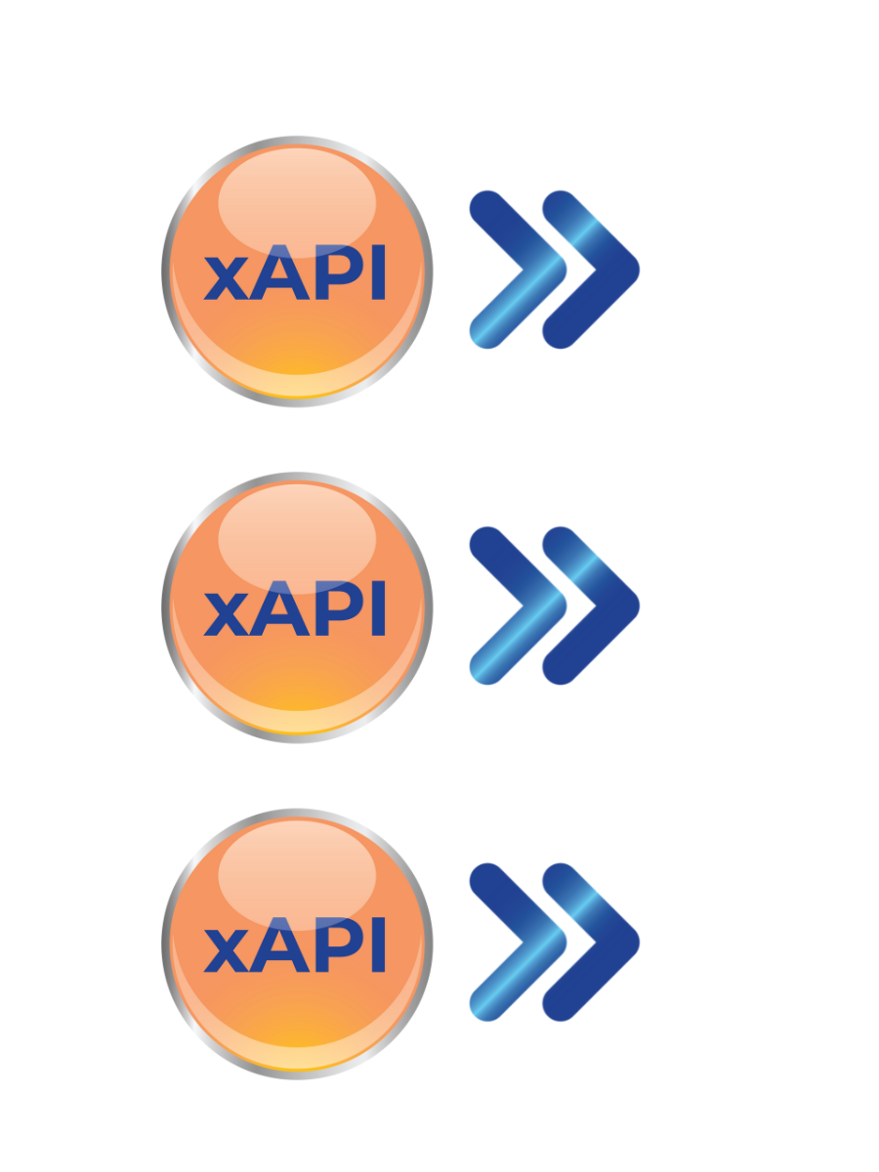




Use Cases
Issue a badge with Credly or Accredible
Credly Acclaim
  Digital Credentials/Certifications
  Follows the Open Badges specification
  REST API
Accredible
  Badges (Open Badges 2.0)
  Digital Certificates
  REST API
Statement
Receiver
Authorized
Statements
Pattern
Matching
Engine
Matched
Triggers
REST
API
Outbound
Processor
xAPI Statements
https://youtu.be/ePrPQ6SwuQo?si=bRVLVKlkPRCUzvEd

Slide 21
Use Cases
Update the Enterprise Learner Record
ADL Project
  Update Targeted Competencies
  Earned Competences
  Deprecated Competencies
User Data (xAPI)
xACTION
Learner Profile
P2997 Data Model
https://youtu.be/YAm2XBvAUC4?si=Gbl1pw_NOlO0UOLi

Slide 22
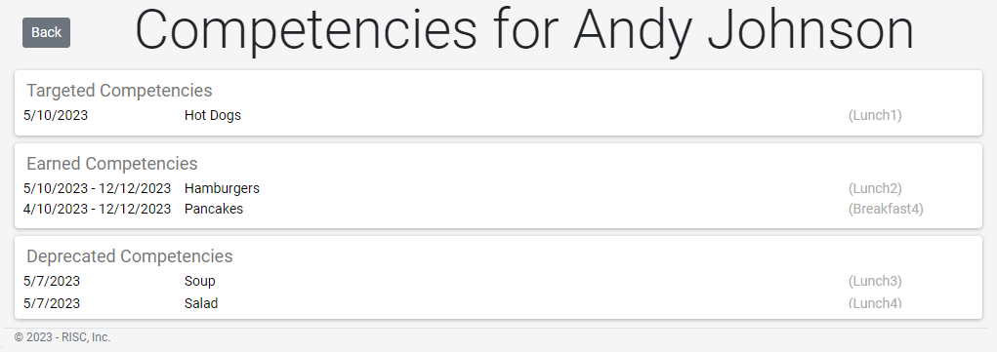
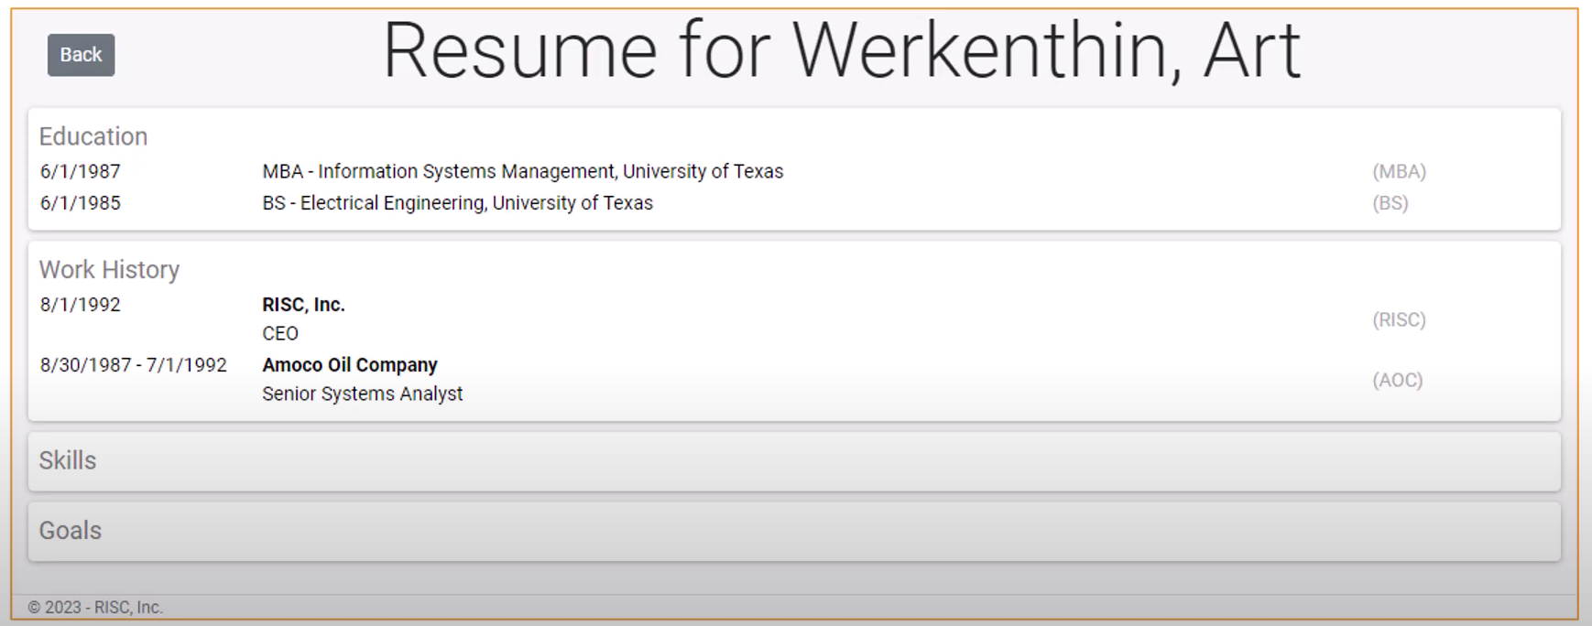
Use Cases
Update the Enterprise Learner Record
ADL Project for “Live Resume” system
  Real time reporting of achievements
  Prototype for combining the ELR and Shareable Competency Definitions

Slide 23
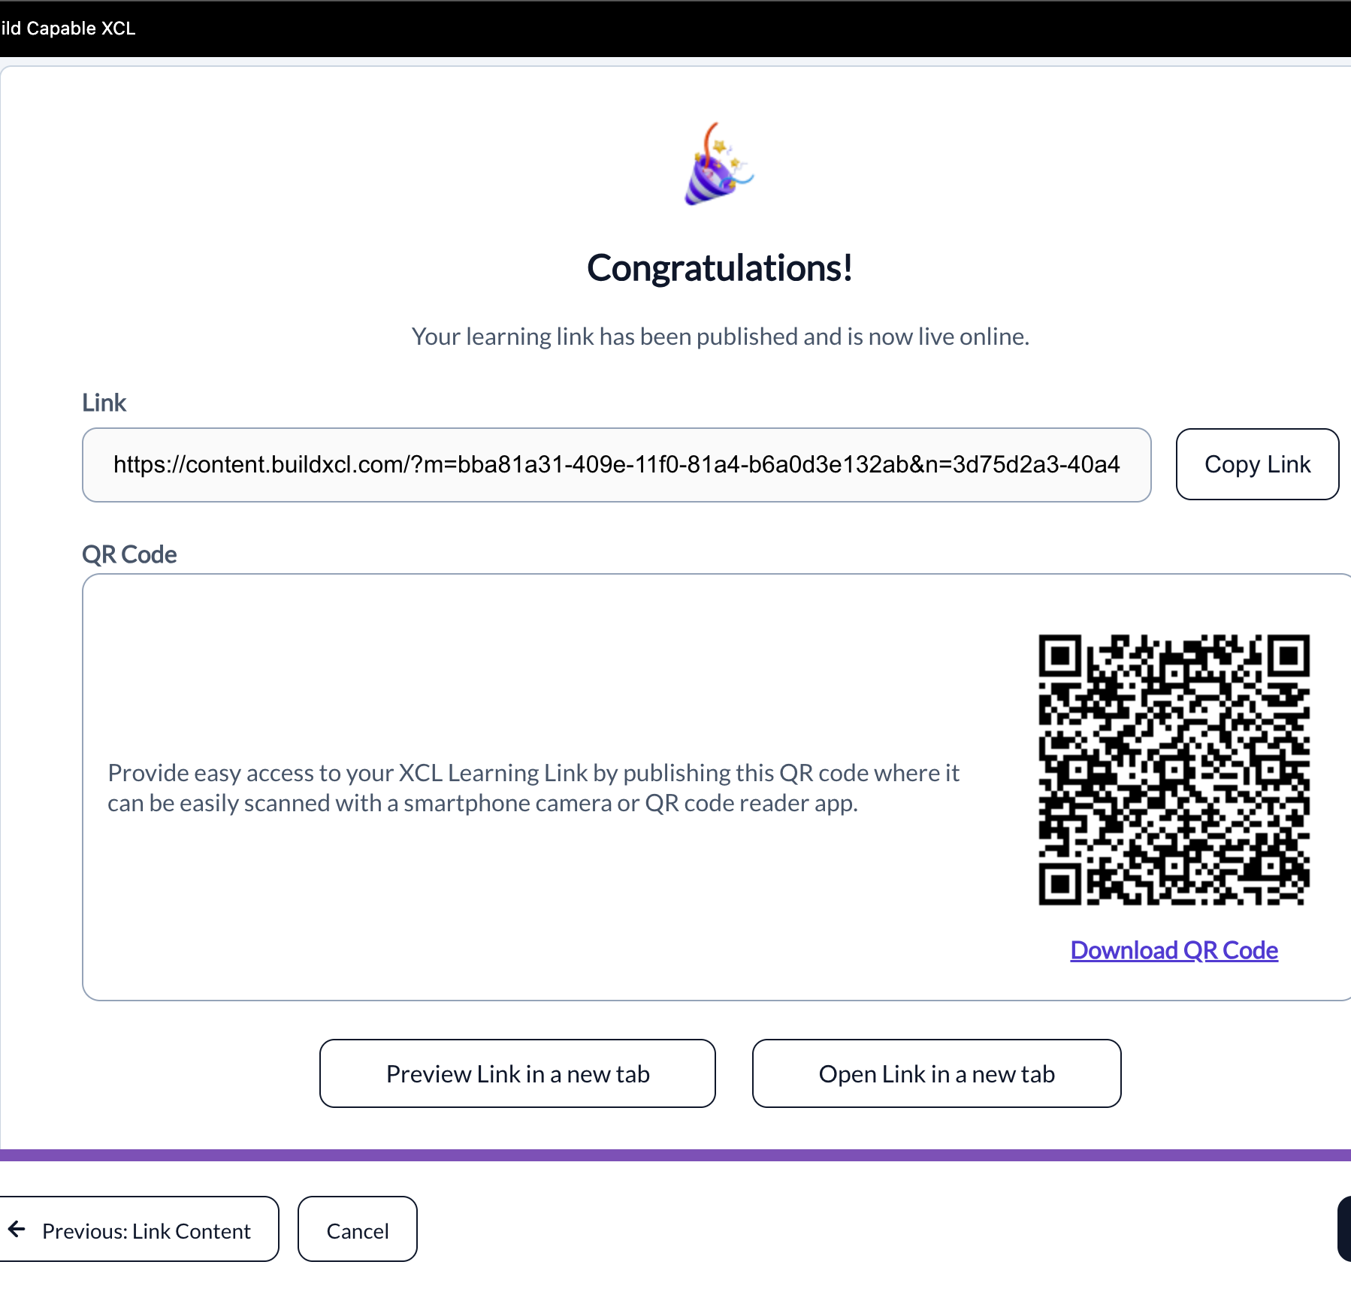
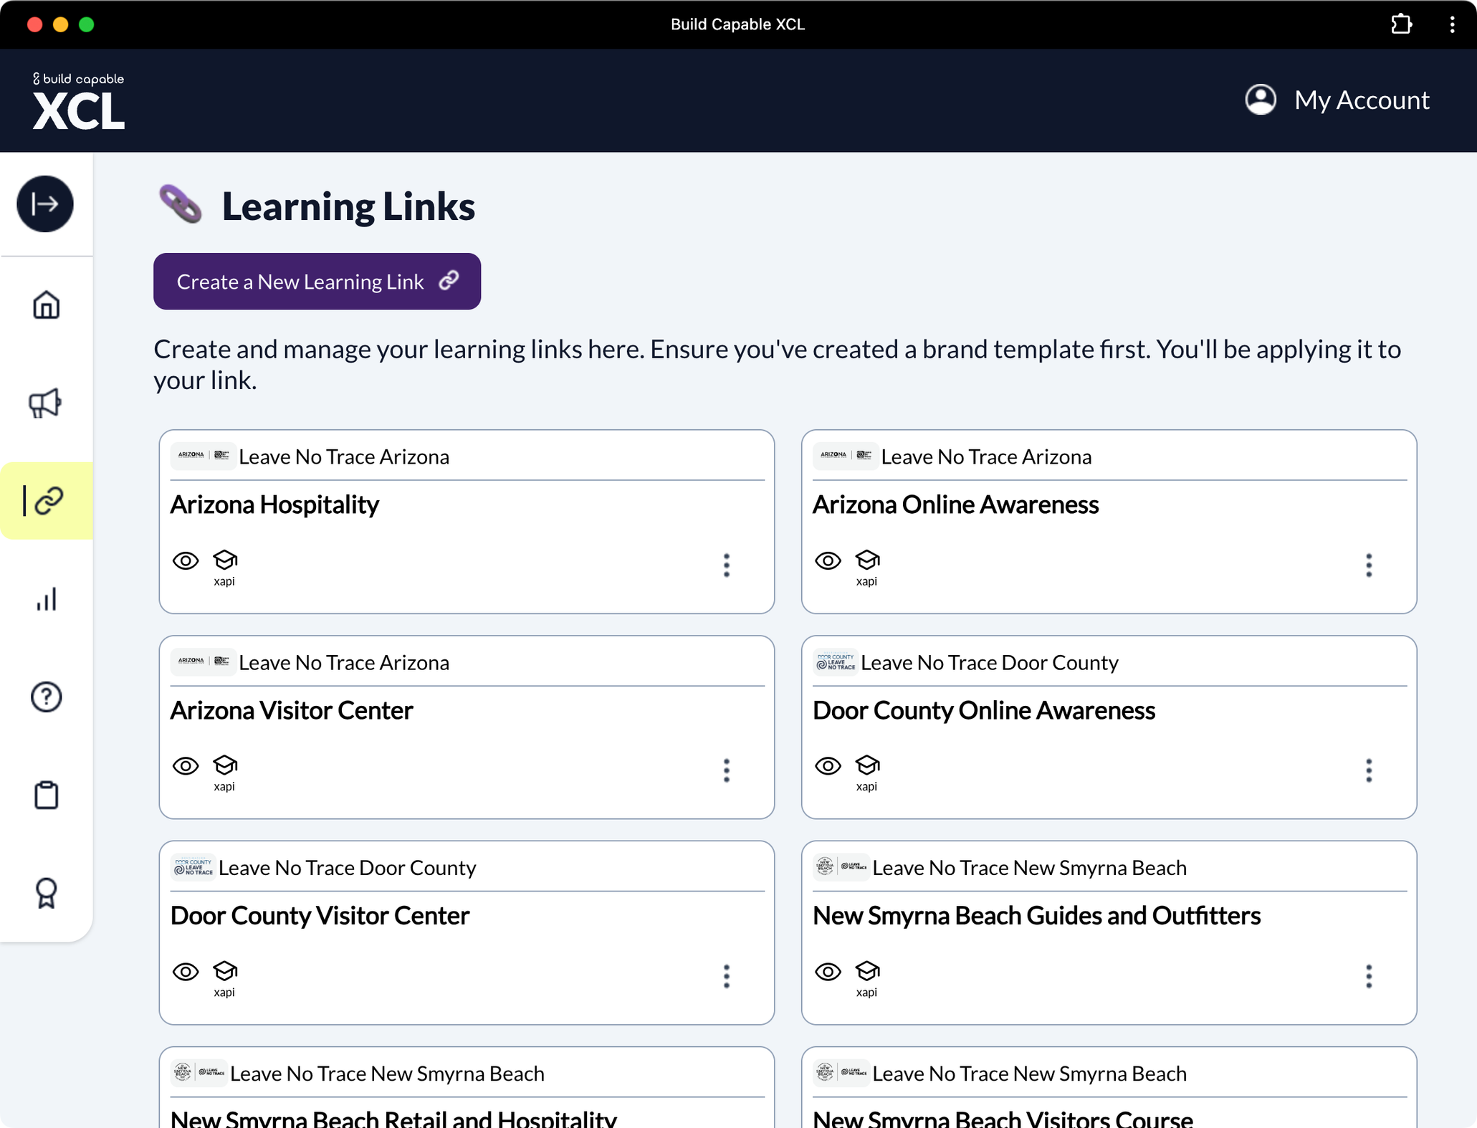
Use Cases
XCL integration for Leave No Trace
Don’t lock training behind the LMS
Link or QR Code for content
Identify Learner via SSO or Form
Automatic Translation to xAPI
Send data to any LRS

Slide 24


Use Cases
XCL integration for Leave No Trace
XCL
Complete 3 XCL Learning Links.
XCL
xACTION
Grant a digital badge
Send 3 “completed” xAPI statements LRS and xACTION.
Send email to Training Administrator advising new badge awarded.
XACTION

Slide 25
Use Cases
XCL integration for Leave No Trace
XCL
Achieve passing score and download required document
XCL
xACTION
Email next Learning Link to student
Send xAPI from LRS and xACTION
Create entry into online transcript
XACTION
Notes:
difficult to implement and administer
relies on an account-based authentication system
requires the back-end processing system
accessibility challenges (pop-ups, iframes

Slide 26
Use Cases
XCL integration for Leave No Trace
XCL
Track interactions from 12 different Learning Links
XCL
xACTION
Give credit in Competency Management System after all activities
Send xAPI “satisfied” and Passed statements for scores >90
Update Analytics Dashboard
XACTION

Slide 27
How Does it Work?
Trigger
Rules
Actions
Notes:
At the core of xAction are Triggers. Triggers consist of rules to match and actions to execute once those rules are matched.

Slide 28
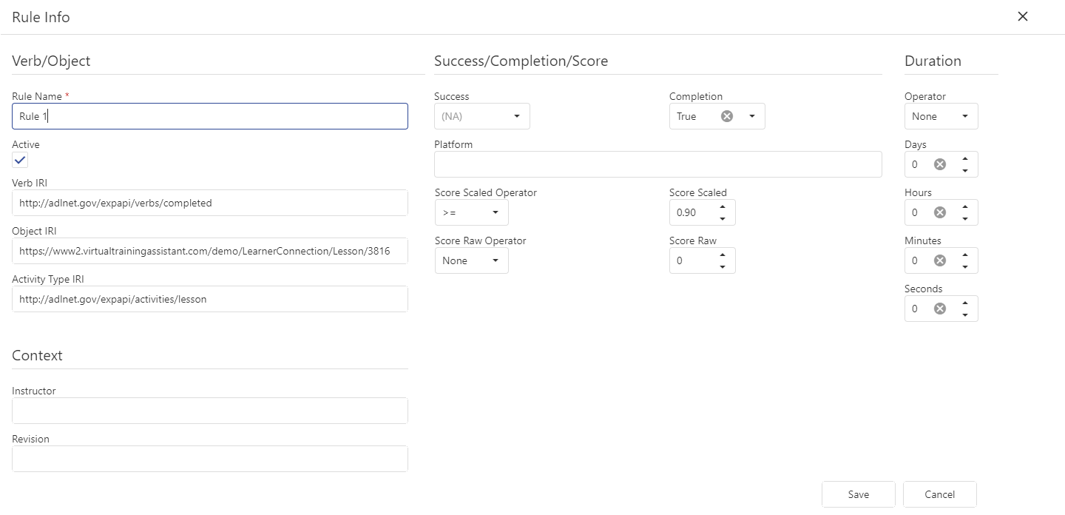

Slide 29
Rules may have context activities & extensions
Rule
Context Activities
Extensions

Slide 30
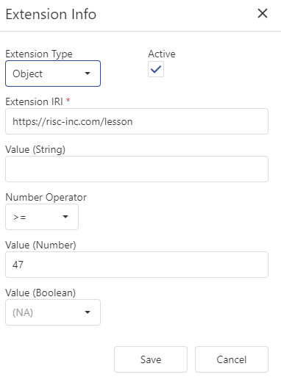
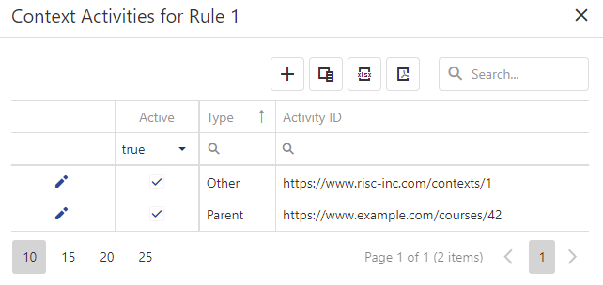

Slide 31
Trigger Actions
Call
Call REST API
Forward
Forward Statement
Transform
Use pieces of incoming statements to make a new statement or create an entirely new statement

Slide 32
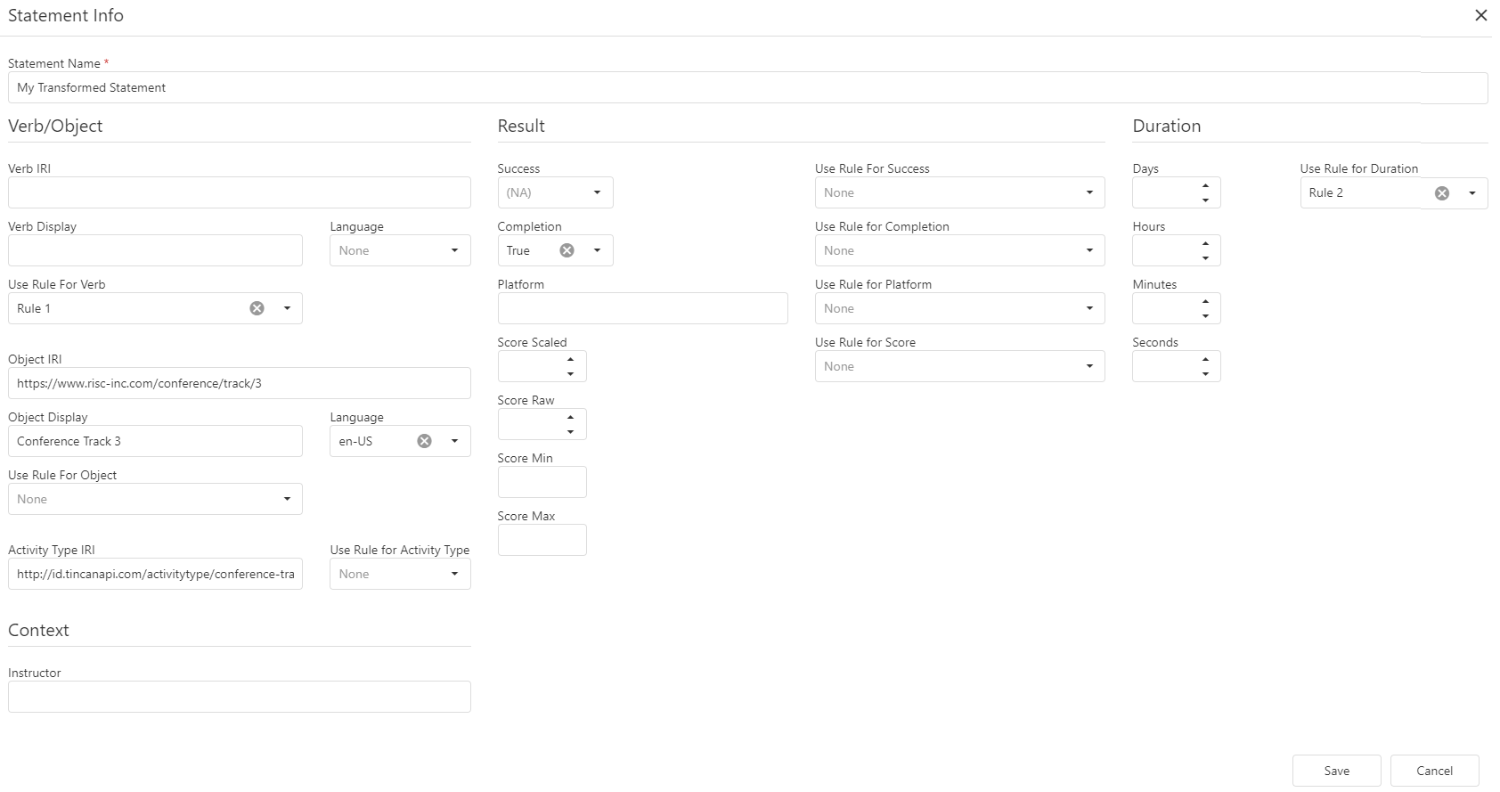

Slide 33
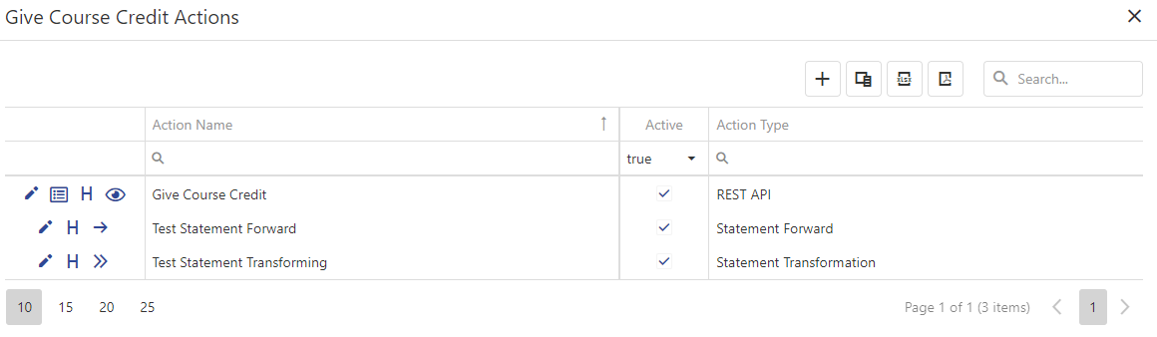
One Trigger may have Many Actions

Slide 34
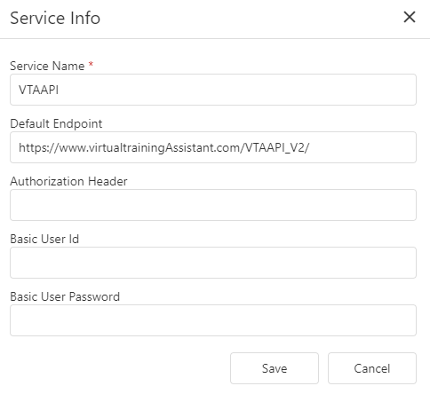
Services
You may need to call multiple APIs that reside at the same endpoint.
Services help by providing “default” properties for an outbound Action.

Slide 35
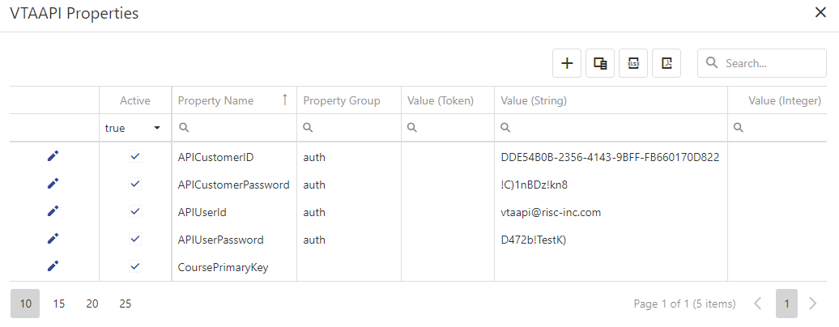
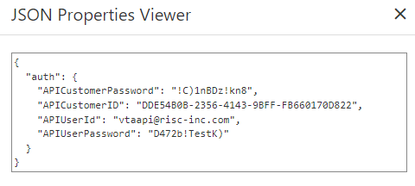
Service Properties
Service properties are JSON data that automatically gets included in any Action that uses the Service.
Service Properties may also be copied into the Action so that their values may be changed for that action.
Tokens can be used to pull data from the incoming statements (ex: Actor info)

Slide 36
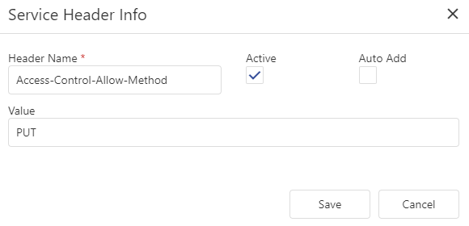
Service Headers
Multiple HttpRequest Headers can be added to Services
Headers will depend on the
3rd-party API you are calling

Slide 37
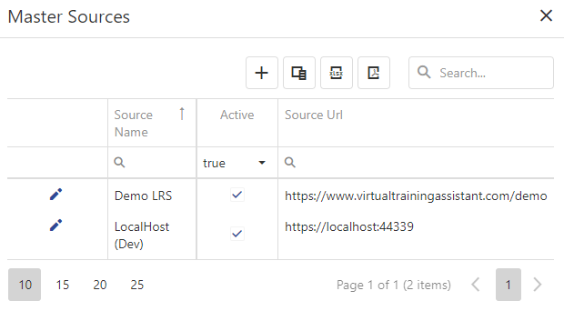
Sources

Slide 38

Connect to learn more…
Duncan Welder
https://xAction.online
https://risc-inc.com
http://www.buildcapable.com/risc
DuncanW@risc-inc.com
https://www.youtube.com/@RISCInc

